Slide 1


SC1007
Data Structures & Algorithms in Python
Lab 2 – Stacks and Queues
Lab Group SR3
2:30pm – 4:20pm
College of Computing and Data Science

Slide 2
Data Structures & Algorithms in Python
Stacks and Queues – Lab Answers
Alistair Yong Jia Jin
College of Computing and Data Science

Slide 3
Linked Lists Recap
A LinkedList consists of a connected sequence of Link/Node objects
Each node contains a reference to a datum and a reference to the next node in the sequence.
  The datum is just an object. It could be just an int or a string, or it could contain a key/data pair.
The last node in the sequence refers to None as its next node
The sequence of nodes is accessed via a “header” object that contains a reference to the first node in the sequence.
head
0x1000
0x1010
0x1020
0x1030
0x10??
John
18
4.0
Anna
21
3.5
Peter
22
3.8
Jane
25
3.7
…
Last
45
4.5
None
0x1010
0x1020
0x1030
Notes:
Here we analyze the basic anatomy of a LinkedList. It consists of a series of interconnected nodes, where each node contains two parts: a reference to the data it holds and a reference to the next node in the sequence.
The data can be any object, such as an integer, a string, or a key-value pair. Each node is linked to the next one in line through its reference, creating a chain of connected nodes. The last node in this sequence points to None, indicating the end of the list. The entire structure is accessed via a header object, which holds a reference to the first node in the list. If the reference to this header is lost, the entire list becomes inaccessible.

Slide 4
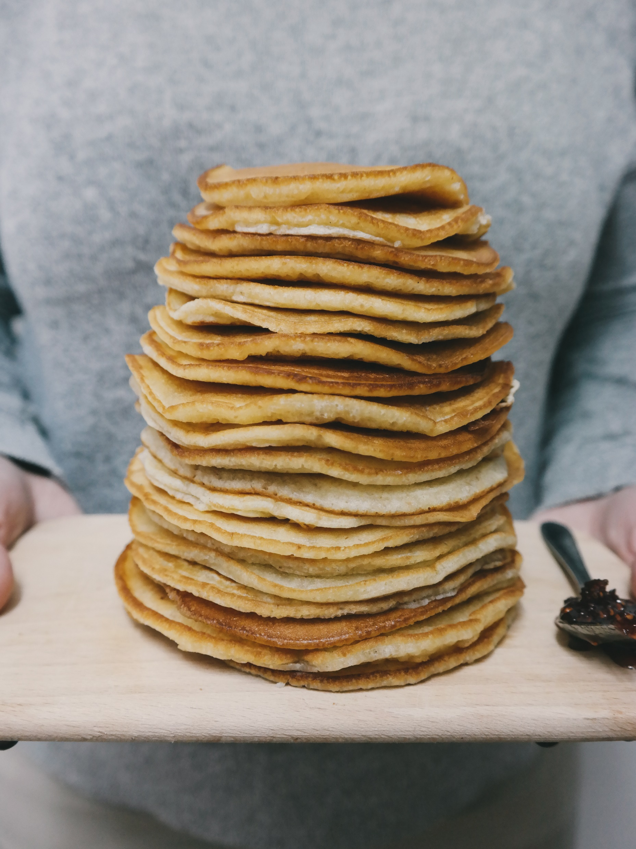
Stacks (of pancakes)
First-In, Last-Out (FILO)
head
5
4
3
2
1
Notes:
<a href="https://stocksnap.io/photo/people-man-UEKFJ08T9T">Photo</a> by <a href="https://stocksnap.io/author/20268">Tohm Brigitte</a> on <a href="https://stocksnap.io">StockSnap</a>

Slide 5
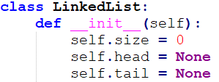

Stacks (of pancakes)
head
5
4
3
2
1
Notes:
<a href="https://stocksnap.io/photo/people-man-UEKFJ08T9T">Photo</a> by <a href="https://stocksnap.io/author/20268">Tohm Brigitte</a> on <a href="https://stocksnap.io">StockSnap</a>

Slide 6

Stacks (of pancakes)
6
5
4
3
2
1
Notes:
<a href="https://stocksnap.io/photo/people-man-UEKFJ08T9T">Photo</a> by <a href="https://stocksnap.io/author/20268">Tohm Brigitte</a> on <a href="https://stocksnap.io">StockSnap</a>

Slide 7
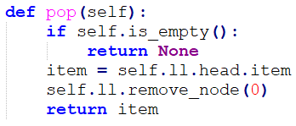

Stacks (of pancakes)
6
5
4
3
2
1
Notes:
<a href="https://stocksnap.io/photo/people-man-UEKFJ08T9T">Photo</a> by <a href="https://stocksnap.io/author/20268">Tohm Brigitte</a> on <a href="https://stocksnap.io">StockSnap</a>

Slide 8
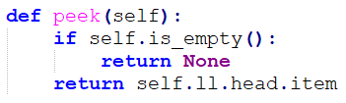
Stacks (of pancakes)
head
5
item
4
3
2
1
Notes:
<a href="https://stocksnap.io/photo/people-man-UEKFJ08T9T">Photo</a> by <a href="https://stocksnap.io/author/20268">Tohm Brigitte</a> on <a href="https://stocksnap.io">StockSnap</a>

Slide 9

Queues (of people)
First-In, First-Out (FIFO)
head
1
2
3
4
5
Notes:
<a href="https://www.vecteezy.com/free-vector/people-queue">People Queue Vectors by Vecteezy</a>

Slide 10

Queues (of people)
head
1
2
3
4
5
Notes:
<a href="https://www.vecteezy.com/free-vector/people-queue">People Queue Vectors by Vecteezy</a>

Slide 11

Queues (of people)
1
2
3
4
5
Notes:
<a href="https://www.vecteezy.com/free-vector/people-queue">People Queue Vectors by Vecteezy</a>

Slide 12
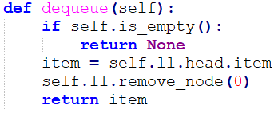

Queues (of people)
1
2
3
4
5
Notes:
<a href="https://www.vecteezy.com/free-vector/people-queue">People Queue Vectors by Vecteezy</a>

Slide 13
Summary
Stacks | Queues
Last-In, First-Out (LIFO) | First-In, First-Out (FIFO)
push() and pop() | enqueue() and dequeue()

Slide 14
Q01 (No AI)
Write a function remove_until() that removes all values from a stack of integers until, but not including, the first occurrence of a given value. If the value is not present, the stack ends up empty. The function accepts two parameters: a reference to the stack and the value to stop at, and returns the stack. The function definition is as follows:
def remove_until(self, stack, value):
Example: Given the stack [1 2 3 4 5 6 5 4 3 2 1], where the rightmost number is the top of the stack, calling remove_until() with value = 5 removes 1, 2, 3 and 4 from the top and produces the stack [1 2 3 4 5 6 5].

Slide 15
Q02 (Normal)
Write a recursive function recursiveReverse() that reverses the order of items stored in a queue of integers. The function accepts a single parameter: a reference to the queue. The function definition is as follows:
def recursiveReverse(queue):
Example:
Input queue: [10, 20, 30, 40, 50]
Output queue: [50, 40, 30, 20, 10]

Slide 16
Q03 (Driver)
Write a function palindrome() that determines whether a given string is a palindrome. The function accepts a single parameter: the word (a string). The function should return True if the string is a palindrome and False otherwise. The function should ignore whitespace, case, and punctuation. The function definition is as follows:
def palindrome(word):
Examples:
Input: "A man a plan a canal Panama"
Output: True
Input: "Superman in the sky"
Output: False

Slide 17
Q04 (Navigator)
Write a function balanced() that determines if an expression comprised of the characters ()[]{} is balanced. The function accepts a single parameter: the expression (a string). The function should return True if the expression is balanced and False otherwise. The function definition is as follows:
def balanced(expression):
The following expressions are balanced because the order and quantity of the parentheses match:
() ([]) {[]}
The following expressions are not balanced:
{{)] [({{)])

Slide 18
Lab Access Code

Slide 19
Q01 (No AI) – Answer
Write a function remove_until() that removes all values from a stack of integers until, but not including, the first occurrence of a given value. If the value is not present, the stack ends up empty. The function accepts two parameters: a reference to the stack and the value to stop at, and returns the stack. The function definition is as follows:
def remove_until(self, stack, value):
Example: Given the stack [1 2 3 4 5 6 5 4 3 2 1], where the rightmost number is the top of the stack, calling remove_until() with value = 5 removes 1, 2, 3 and 4 from the top and produces the stack [1 2 3 4 5 6 5].

Slide 20
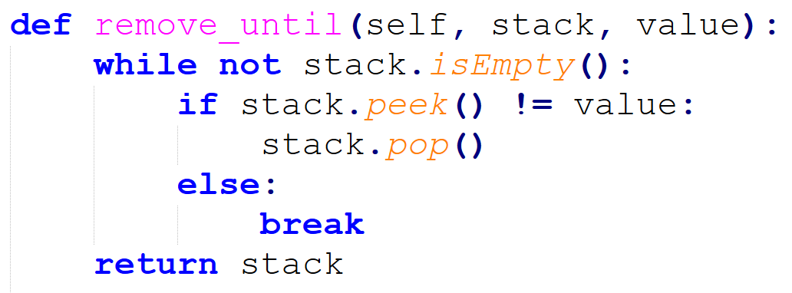
Q01 (No AI) - Answer
value = 3
6
5
4
3
2
1

Slide 21
Q01 (No AI) - Answer
value = 3
3
2
1

Slide 22
Q02 (Normal) – Answer
Write a recursive function recursiveReverse() that reverses the order of items stored in a queue of integers. The function accepts a single parameter: a reference to the queue. The function definition is as follows:
def recursiveReverse(queue):
Example:
Input queue: [10, 20, 30, 40, 50]
Output queue: [50, 40, 30, 20, 10]

Slide 23
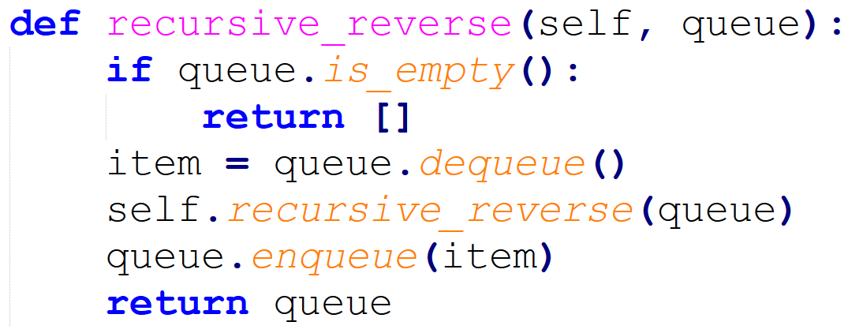
Q02 (Normal) – Answer
recursive_reverse()
recursive_reverse()
head
1
2
3
item

Slide 24
Q02 (Normal) – Answer
recursive_reverse()
item
1
recursive_reverse()
recursive_reverse()
head
2
3
item

Slide 25
Q02 (Normal) – Answer
recursive_reverse()
recursive_reverse()
item
1
item
2
recursive_reverse()
recursive_reverse()
head
3
item

Slide 26
Q02 (Normal) – Answer
recursive_reverse()
recursive_reverse()
item
1
item
2
recursive_reverse()
recursive_reverse()
head
item
3

Slide 27
Q02 (Normal) – Answer
recursive_reverse()
recursive_reverse()
item
1
item
2
recursive_reverse()
head
item
3

Slide 28
Q02 (Normal) – Answer
recursive_reverse()
item
1
recursive_reverse()
recursive_reverse()
head
3
item
2

Slide 29
Q02 (Normal) – Answer
recursive_reverse()
item
1
recursive_reverse()
head
3
item
2

Slide 30
Q02 (Normal) – Answer
recursive_reverse()
recursive_reverse()
head
3
2
item
1

Slide 31
Q02 (Normal) – Answer
recursive_reverse()
head
3
2
item
1

Slide 32
Q03 (Driver) – Answer
Write a function palindrome() that determines whether a given string is a palindrome. The function accepts a single parameter: the word (a string). The function should return True if the string is a palindrome and False otherwise. The function should ignore whitespace, case, and punctuation. The function definition is as follows:
def palindrome(word):
Examples:
Input: "A man a plan a canal Panama"
Output: True
Input: "Superman in the sky"
Output: False

Slide 33
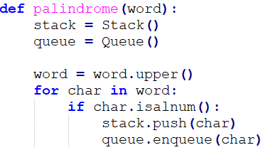
Q03 (Driver) – Answer
R
A
D
R
A
D
A
R
A
R

Slide 34
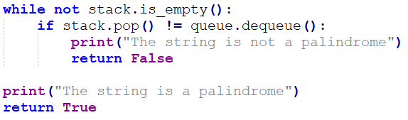
Q03 (Driver) – Answer
R
A
D
R
A
D
A
R
A
R
Notes:
Given solution includes
while stack.ll.size >queue.ll.size:
stack.pop()

Slide 35
Q04 (Navigator) – Answer
Write a function balanced() that determines if an expression comprised of the characters ()[]{} is balanced. The function accepts a single parameter: the expression (a string). The function should return True if the expression is balanced and False otherwise. The function definition is as follows:
def balanced(expression):
The following expressions are balanced because the order and quantity of the parentheses match:
() ([]) {[]}
The following expressions are not balanced:
{{)] [({{)])

Slide 36
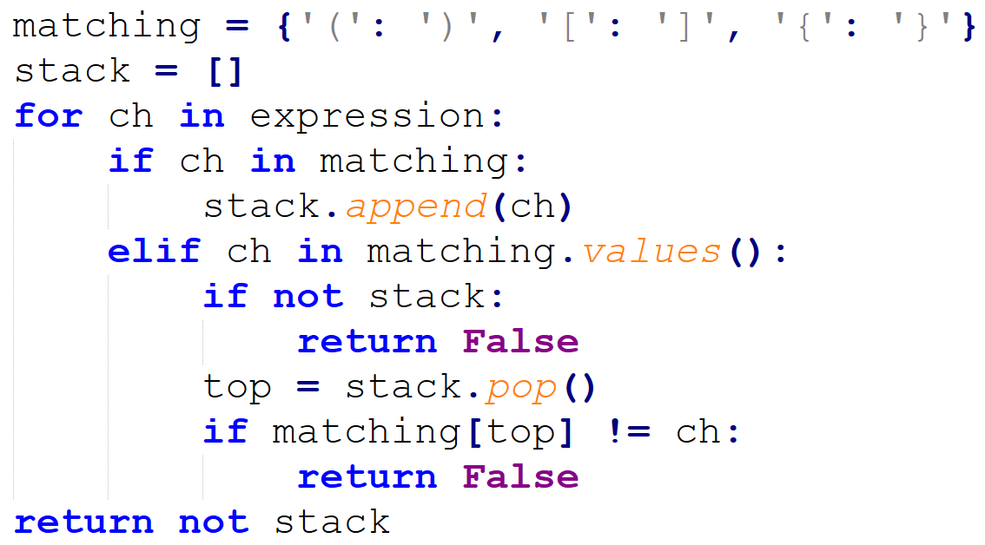
Q04 (Navigator) – Answer
Create a dictionary with the three different open and close parantheses as well as an empty stack.
Iterate through each character in the given expression using a for loop.
If the character is an open parantheses, push the character onto the stack.
Else if the character is a closed parantheses, check if the stack is empty or the popped character from the stack matches the current parantheses, and return false if either is true.
At the end of the for loop return whether the stack is empty or not.
Notes:
Alternate solution
Create a function that checks if the given expression of parantheses is valid i.e. for every '(' there is a corresponding ‘)’
Modify the code such that it can handle '{', '}', '[', ']'

Slide 37
Q04 (Navigator) – Answer
Create a dictionary with the three different open and close parantheses as well as an empty stack.
Iterate through each character in the given expression using a for loop.
If the character is an open parantheses, push the character onto the stack.
Else if the character is a closed parantheses, check if the stack is empty or the popped character from the stack matches the current parantheses, and return false if either is true.
At the end of the for loop return whether the stack is empty or not.
Notes:
Alternate solution
Create a function that checks if the given expression of parantheses is valid i.e. for every '(' there is a corresponding ‘)’
Modify the code such that it can handle '{', '}', '[', ']'

Slide 38
Q04 (Navigator) – Answer
Create a dictionary with the three different open and close parantheses as well as an empty stack.
Iterate through each character in the given expression using a for loop.
If the character is an open parantheses, push the character onto the stack.
Else if the character is a closed parantheses, check if the stack is empty or the popped character from the stack matches the current parantheses, and return false if either is true.
At the end of the for loop return whether the stack is empty or not.
Notes:
Alternate solution
Create a function that checks if the given expression of parantheses is valid i.e. for every '(' there is a corresponding ‘)’
Modify the code such that it can handle '{', '}', '[', ']'

Slide 39
Q04 (Navigator) – Answer
Create a dictionary with the three different open and close parantheses as well as an empty stack.
Iterate through each character in the given expression using a for loop.
If the character is an open parantheses, push the character onto the stack.
Else if the character is a closed parantheses, check if the stack is empty or the popped character from the stack matches the current parantheses, and return false if either is true.
At the end of the for loop return whether the stack is empty or not.
Notes:
Alternate solution
Create a function that checks if the given expression of parantheses is valid i.e. for every '(' there is a corresponding ‘)’
Modify the code such that it can handle '{', '}', '[', ']'

Slide 40
Q04 (Navigator) – Answer
Create a dictionary with the three different open and close parantheses as well as an empty stack.
Iterate through each character in the given expression using a for loop.
If the character is an open parantheses, push the character onto the stack.
Else if the character is a closed parantheses, check if the stack is empty or the popped character from the stack matches the current parantheses, and return false if either is true.
At the end of the for loop return whether the stack is empty or not.
Notes:
Alternate solution
Create a function that checks if the given expression of parantheses is valid i.e. for every '(' there is a corresponding ‘)’
Modify the code such that it can handle '{', '}', '[', ']'

Slide 41
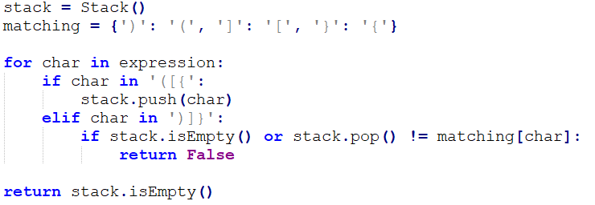
Q04 (Navigator) – Answer
[ ] [ ( ) ]
[

Slide 42
Q04 (Navigator) – Answer
[ ] [ ( ) ]
[

Slide 43
Q04 (Navigator) – Answer
[ ] [ ( ) ]
[

Slide 44
Q04 (Navigator) – Answer
[ ] [ ( ) ]
(
[

Slide 45
Q04 (Navigator) – Answer
[ ] [ ( ) ]
(
[

Slide 46
Q04 (Navigator) – Answer
[ ] [ ( ) ]
[

